Slide 1
Chapter 3
REQUIREMENTS ENGINEERING AND PRINCIPLES
Total Hour:7hrs
Presented by
Er.Harendra Bikram Shah
Lecturer
Department of Computer Engineering
NAST

Slide 2
OUTLINES
3.1 Types of Requirements
3.2 Requirements Modeling Principles
3.3 Domain Analysis and System Models
3.3.1 Context Models
3.3.2 Behavioral Models
3.3.3 Data Models
3.4 Requirements Engineering Process
3.4.1 Feasibility Study
3.4.2 Requirements Elicitation, Analysis,
Modeling, Specification
3.4.3 Requirements Validation
3.5 Object Oriented Analysis

Slide 3
Introduction to Requirements
According to IEEE standard 729, a requirement is defined as follows:
A condition or capability needed by a user to solve a problem or achieve an objective
A condition or capability that must be met or possessed by a system or system component to satisfy a contract, standard, specification or other formally imposed documents
A documented representation of a condition or capability, as in 1 and 2.
Requirements is description of features and functionalities of the target system.

Slide 4
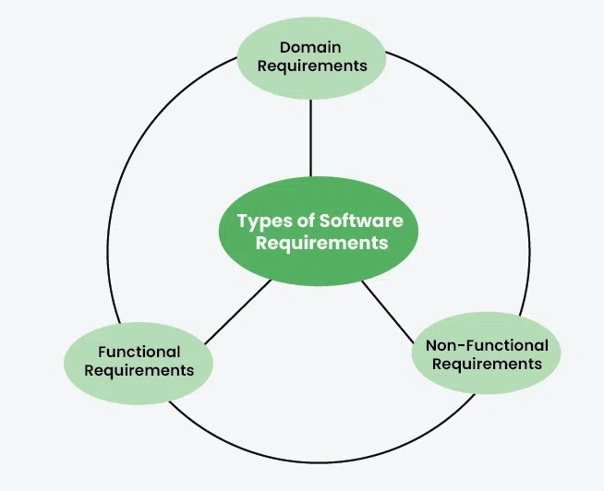
Types of Software Requirements

Slide 5
Types of Software Requirements
Advantages of Classifying Software Requirements:
Better organization:
Improved communication:
Increased quality:
Improved traceability:
Disadvantages of classifying software Requirements
Complexity:
Rigid structure:
Misclassification:

Slide 6
Requirements Modeling Principles
It is crucial phase in the software development lifecycle, where we translate abstract needs and goals into concrete, tangible representations.
1. Abstraction:
2. Decomposition:
3. Projection:
4. Modularity:
5. Consistency:
6. Completeness:
7. Correctness:
8. Traceability:
9. Understandability:

Slide 7
Domain Analysis and System Models
process of studying and understanding the business domain, or problem space, where the system will operate.
It involves identifying the key concepts, relationships, and rules within that domain.
This analysis helps in building a solid foundation for the design and development of software systems.
Key Steps in Domain Analysis:
Identify the Domain:
Identify Key Concepts:
Define Relationships:
Identify Rules and Constraints:
5. Create a Domain Model:

Slide 8
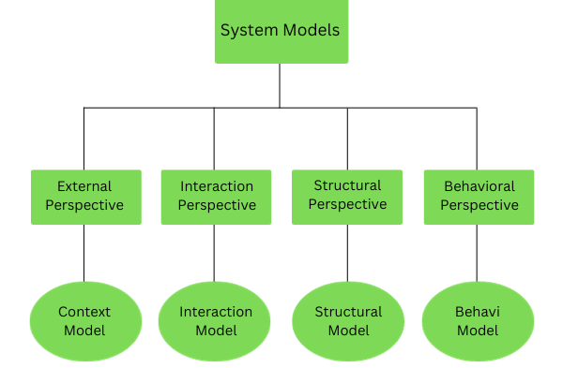
Domain Analysis and System Models
System Models:
System models are representations of a system's structure, behavior, and interactions with its environment.
They help in understanding the system's requirements, design, and implementation.

Slide 9
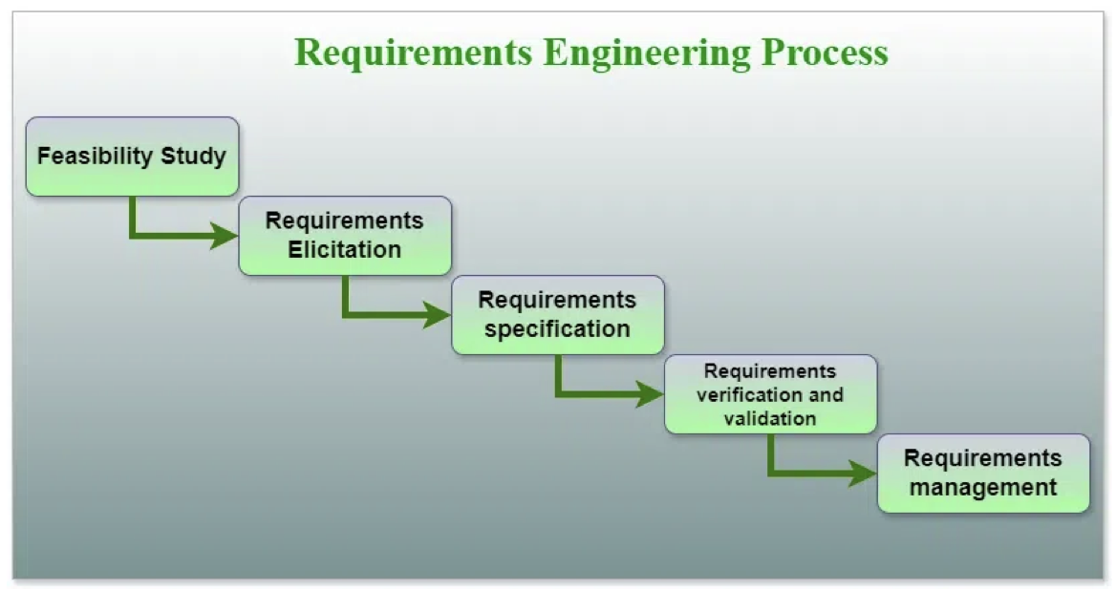
Requirements Engineering
A systematic and strict approach to the definition, creation, and verification of requirements for a software system.

Slide 10
Requirements Engineering
Tools Involved in Requirement Engineering:
Observation report
Questionnaire (survey, poll )
Use cases
User stories
Requirement workshop
Mind mapping
Roleplaying
Prototyping
Advantages of Requirements Engineering Process
meets the needs and expectations of the stakeholders
cost-effective and efficient manner
improve communication and collaboration between the development team and stakeholders
ensure the software system meets the needs of all stakeholders.
Provides a solid foundation for the development process, which helps to reduce the risk of failure.

Slide 11
Requirements Engineering
Disadvantages of Requirements Engineering Process:
Can be time-consuming and costly.
Can be difficult to ensure that all stakeholders’ needs and expectations are considered
challenging to ensure that the requirements are clear, consistent, and complete
Changes in requirements can lead to delays and increased costs in the development process.
Requirements may change over time, which can result in delays and additional costs.
There may be conflicts between stakeholders, which can be difficult to resolve.

Slide 12
Object Oriented Analysis
OOA is a software engineering approach that focuses on identifying and modeling the objects within a system and their interactions.
It's the first step in the object-oriented design (OOD) process.
Key Concepts in OOA:
Objects:
Classes: .
Inheritance:
Polymorphism:
Encapsulation:
Steps in OOA:
Identify Objects:
Identify Attributes:
Identify Methods:
Identify Relationships:
Create a Class Diagram:
Benefits of OOA:
Modularity:
Reusability:
Maintainability:
Flexibility:

Slide 13
Object Oriented Analysis
Challenges of OOA:
Complexity:
Learning Curve:
Design Decisions:
Tools for OOA:
UML (Unified Modeling Language):
Rational Rose:
Visual Paradigm:

Slide 14
Object Oriented Analysis Design
It is a way to design software by thinking of everything as objects similar to real-life things.
In OOAD, we first understand what the system needs to do, then identify key objects, and finally decide how these objects will work together.
Furthermore, as part of the object-oriented design process, it is essential to define specific aspects:
Data Organization of Attributes:
  OOD involves specifying how data attributes are organized within the objects.
  This includes determining the types of data each object will hold and how they relate to one another.
Procedural Description of Operations:
  OOD requires a procedural description for each operation that an object can perform.
  This involves detailing the steps or processes involved in carrying out specific tasks.

Slide 15
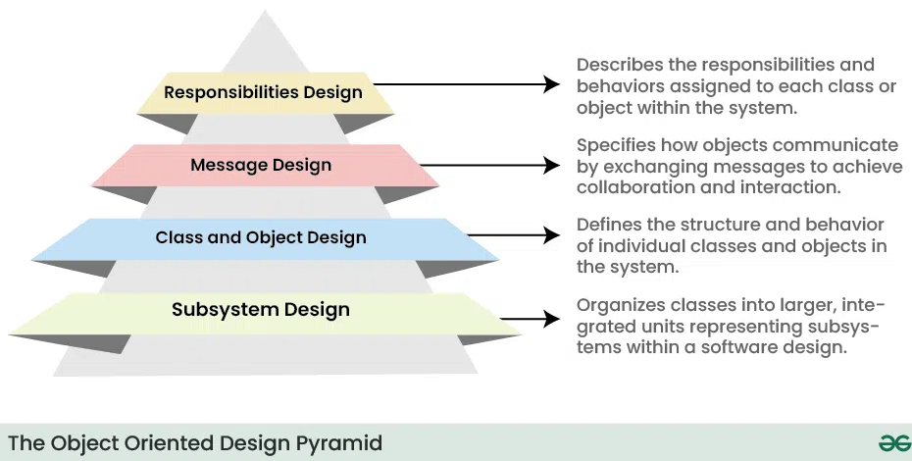
Object Oriented Analysis Design

Slide 16
Object Oriented Analysis Design
Benefits of Object-Oriented Analysis and Design(OOAD)
It increases the modularity and maintainability of software
It provides a high-level, abstract representation of a software system, making understanding and maintenance easier.
It promotes object-oriented design principles and the reuse of objects
It can assist developers in creating scalable software systems that can adapt to changing user needs and business demands
Challenges of Object-Oriented Analysis and Design(OOAD)
might complicate a software system.
may result in additional overhead and reduce the software’s speed.
challenging learning curve
It can be a time-consuming process that involves significant upfront planning and documentation.
OOAD can be more expensive than other software engineering methodologies due to the upfront planning and documentation required.

Slide 17
Object Oriented Analysis Design
Real world applications of Object-Oriented Analysis and Design(OOAD)
Banking Software:
Electronic Health Record (EHR) Systems:
Flight Control Systems:
Telecom Billing Systems:
Online Shopping Platforms:

Slide 18
End of the Unit

Slide 19
THANK YOU

